Slide 1

Enhancing Transnational Intelligence:
Forecasting Conflict Fatalities in Africa
MIE1624 - Alternate Group Project
Group 8

Slide 2
01
Armed conflicts:
trends, consequences, and why analyze
them?

Slide 3
The United Nations reports armed conflict fatalities rose 72% in 2023 [1].
The consequences:
(2023 global)
33,000
110 million
Civilian fatalities
Civilians displaced
In 2017 the UN called for ‘early-warning early-action’ procedures to support efforts
to mitigate conflict consequences

Slide 4
02
What is our goal and scope? What data are we using?

Slide 5
Our goal: leverage conflict fatalities data into a machine learning model for forecasting fatalities in Africa
Objective 1*
(current)
Objective 2*
(current)
Objective 3
(long-term)
Identify data features and signals closely related to conflict fatalities for nations
Explore and evaluate state of the art machine learning models for forecasting
Propose actionable strategies for conflict prevention and mitigation
* Focus of this presentation

Slide 6

Why focus on Africa?
Where is our data coming from?
Equity and historical considerations
Africa has experienced severe humanitarian crises in recent years such as in Rwanda (1994), Sudan (2013) and Ethiopia (2022). Armed conflicts arise due to arbitrary borders previously set by colonial powers and high ethnic heterogeneity, whose consequences are exacerbated by inept leadership, poverty and corruption [2].
Violence Early-Warning System (ViEWS)
Dataset reports monthly armed conflict fatalities from 1990 to 2024 for over 191 countries, including 131 data features ranging from population metrics, GDP, gender equality, government form.
More about ViEWS here: https://viewsforecasting.org/

Slide 7
03
What insights can we draw from the conflict data before forecasting?

Slide 8
Data is highly skewed and imbalanced
Percentage of target values that are zero (no fatality of this conflict type for the month across all countries):
State-based conflict - 82.6%
Non-state based conflict - 90.5%
One-sided conflict - 83.6%
Very high disparity among share of fatalities:
7 countries recorded no fatalities from 1990 to 2024
Top 5 countries account for 80% of all fatalities (Rwanda, Ethiopia, Congo DRC, Sudan, Nigeria)
Target variables show weak to no correlation amongst each other

Slide 9
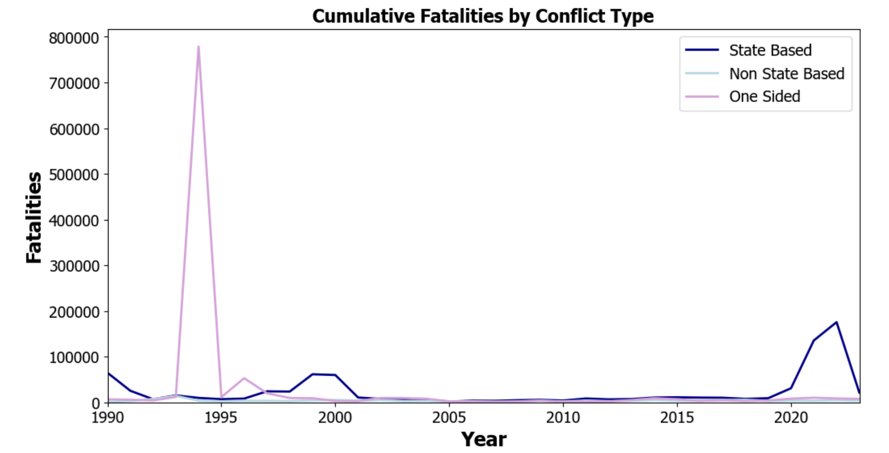
Temporal distribution of fatalities is dictated by extreme outlier events
Rwanda Genocide
Ethiopia Civil Conflict

Slide 10
04
Forecasting conflict fatalities using Machine Learning

Slide 11
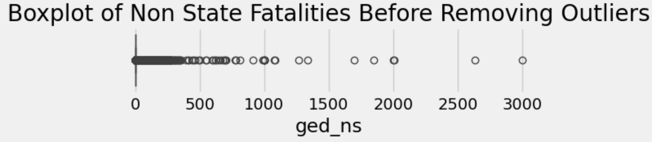
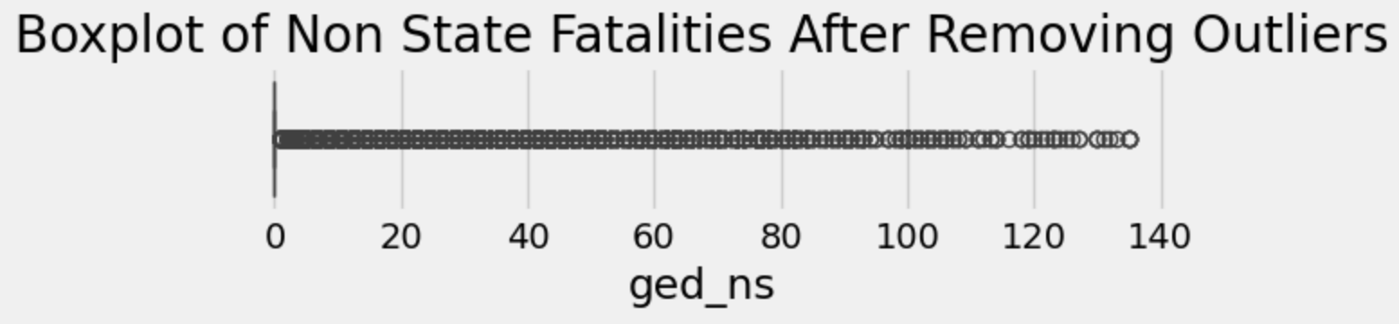
Bird’s Eye View of our Methods
Data cleaning and processing
(1) Drop redundant columns. (2) Remove extreme outliers using percentile-based trimming (keep up to 99th percentile fatalities).
More consistent after removing outliers
Feature engineering
(1) Search for external data features based on previous knowledge e.g. temperature and seasonal data*. (2) Generate lag columns from existing features.
Feature selection and statistical modeling
(1) Use Mutual Information and Spearman Correlation to select/drop features.
(2) Implement ARIMA statistical model to identify temporal patterns.
*Temperature and gun violence study in North America: https://lcerpa.org/

Slide 12
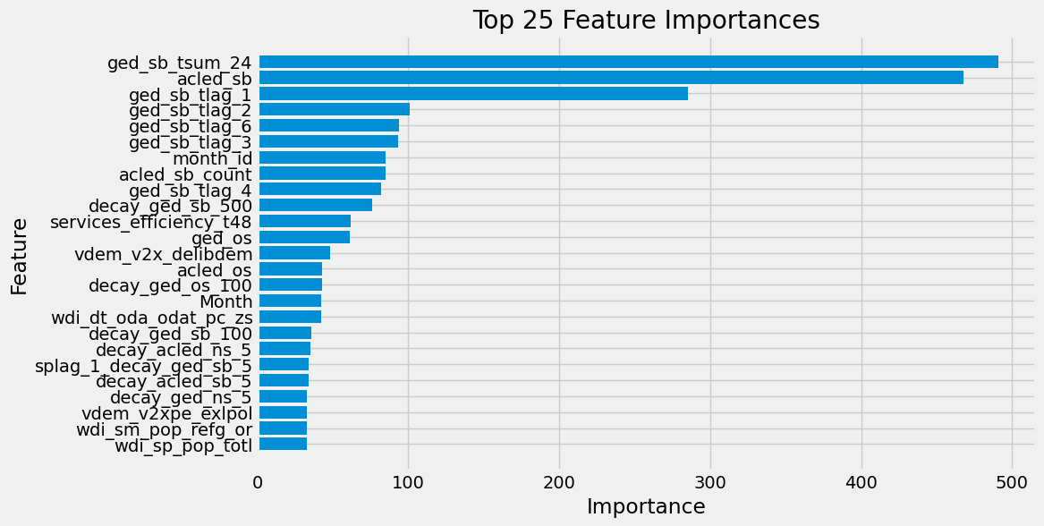
Bird’s Eye View of our Methods
Feature selection - most important features found
Most important features:
24-month moving sum
Number of conflicts
1-month temporal lag
2-month temporal lag
6-month temporal lag
3-month temporal lag
Very high emphasis on
previous fatalities and
lag features

Slide 13
Training a Forecasting ML Model
Forecasting period and train-test split
Our model predicts one year of monthly fatalities for all Africa. The focus of this presentation will be on forecasting 2022 using 1990 to 2021 data.
Model selection, hyperparameters and cross validation technique
Ensemble tree based model used:
XGBoost (Extreme Gradient Boosting)
Key hyperparameters to optimize via Grid Search
Max tree depth, number of leaves, class weights, learning rate
Time series split for cross validation:
Split training data into 5 folds and assess root mean squared error for each
Next step: generate results

Slide 14
05
What are our results?
What did we learn?
What’s next?

Slide 15
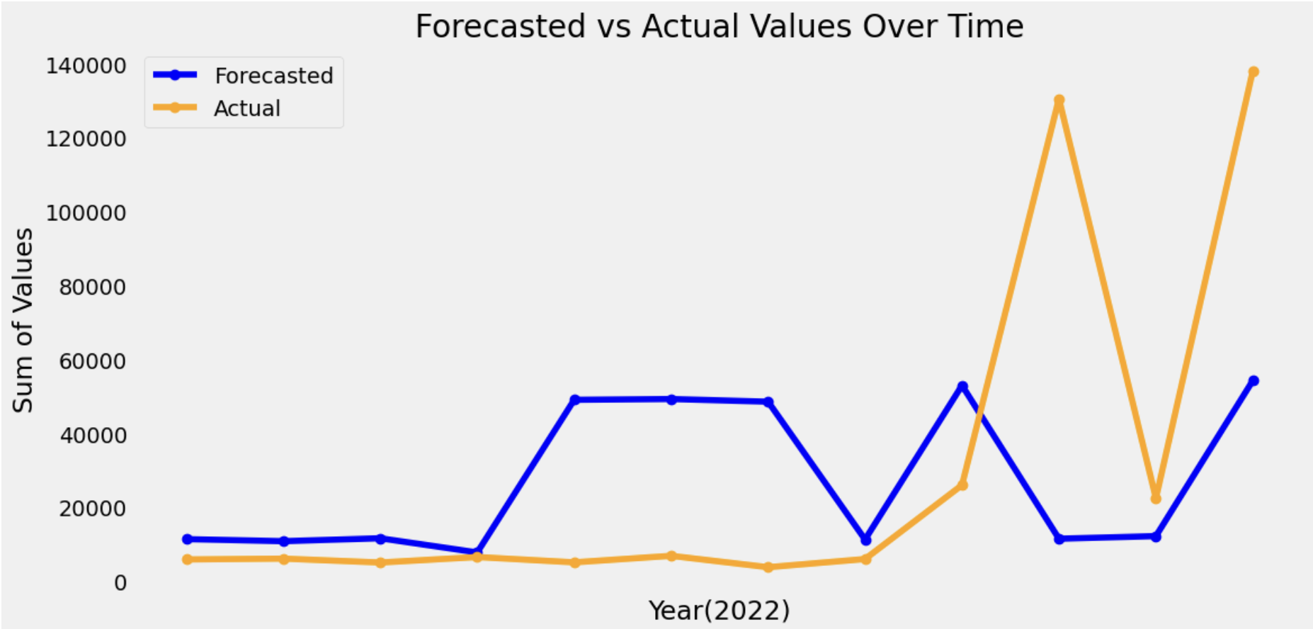
While not perfect, preliminary results are encouraging
Test set error (RMSE=2711.2, MAE=111.7) → not great, but are we capturing trends?
Generally yes, with some major exceptions. But what occurred in reality?
Offensive attacks launched in Ethiopia (fighting shockingly erupts after previous cease-fire agreement) [3]
Forecasted and actual cumulative state-based fatalities for all Africa in 2022

Slide 16
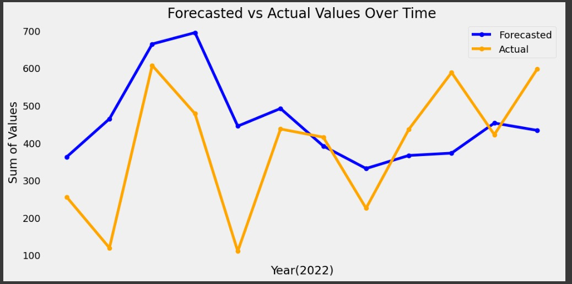
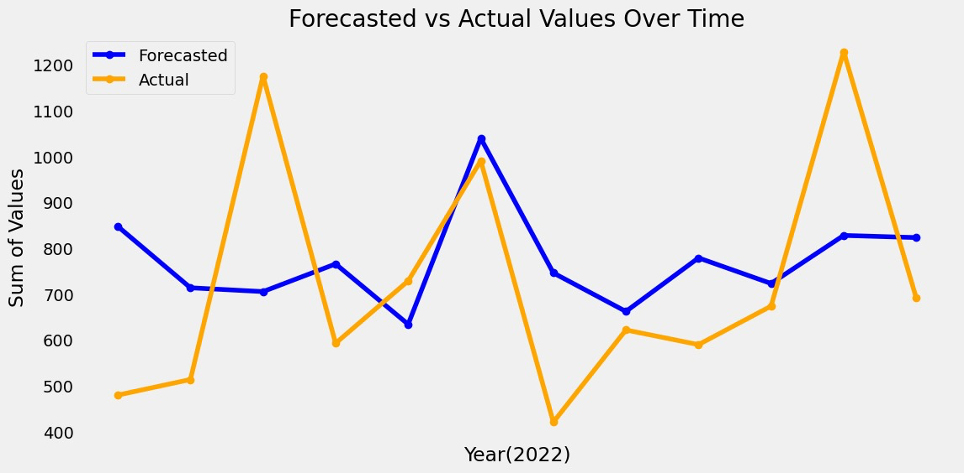
How about for the other conflict types?
Forecasted and actual cumulative non-state fatalities for all Africa in 2022
Forecasted and actual cumulative one-sided fatalities for all Africa in 2022
Test set error:
(RMSE=27.4, MAE=8.7)
Test set error:
(RMSE=37.5, MAE=8.4)
For best results, optimize hyperparameters for each target variable model

Slide 17
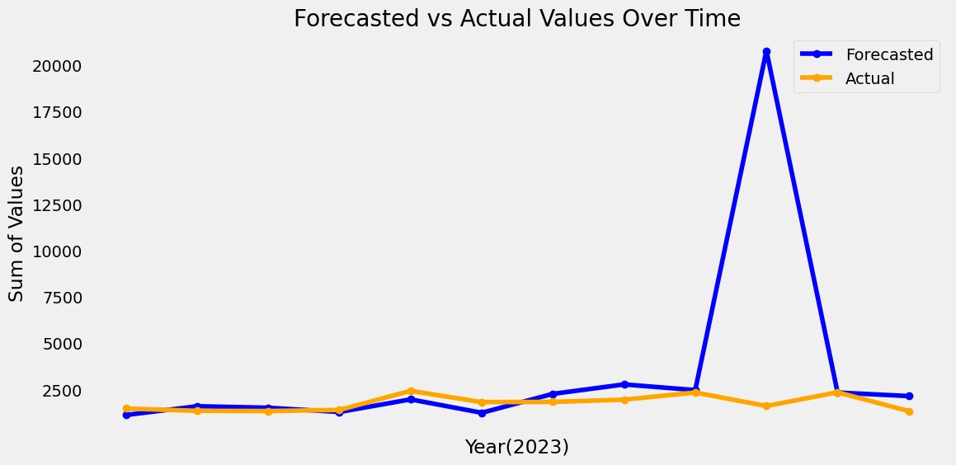
What if we forecast for other years?
Forecasted and actual cumulative state-based fatalities for all Africa in 2023
Test set error:
(RMSE=761.2, MAE=51.6)

Slide 18
Thanks! Questions?
Where do we go from here?
Stay encouraged: fatalities are highly dependent on geo-political conditions, not a simple relationship.
Refine and improve: experiment with more feature engineering, investigate higher complexity models, etc.
Keep overall goal in mind: continue to relate analysis and results towards mitigating conflict consequences to inform proactive decision making.

Slide 19
Citations
[1] United Nations. (2024, May 21). We Must Go Above, Beyond Compliance, Fully Protect Civilians against ‘Harms They Are Suffering on Our Watch’, Senior Humanitarian Official Tells Security Council. United Nations. https://press.un.org/en/2024/sc15702.doc.htm#:~:text=Syria%20and%20Ukraine.-,In%20total%2C%20the%20United%20Nations%20alone%20recorded%20more%20than%2033%2C000,transport%20and%20patients%20were%20recorded.
[2] Aremu, J. O. (2010). Conflicts in Africa: Meaning, Causes, Impact and Solution. African Research Review, 4(4), Article 4. https://doi.org/10.4314/afrrev.v4i4.69251
[3] Jazeera, A. (2022, November 10). Two years of Ethiopia’s Tigray conflict: A timeline. Aljazeera. https://www.aljazeera.com/news/2022/11/10/two-years-of-ethiopias-tigray-conflict-a-timeline

